Slide 1
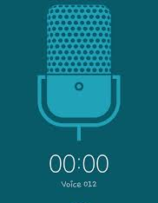
VOICE RECORDER
Mrs.K.Deepa
Assistant Professor, ADU

Slide 2

What it is???
Voice recorder is a cloud-based, call recording solution that helps organizations record calls for subsequent use and keep records of conversations between agents (Teachers) and customers (Students)
This helps teachers analyze students’ views and competency more effectively

Slide 3
A voice recorder is essentially
  a digital device that records sound
  saves it in file format and
  transfers it to another device, such as a computer
Popular file types include MP3 and Audio Interchange File Format (AIFF)

Slide 4
How it Works…
Voice recorder is typically a pre-installed feature of a VoIP phone system, so you can control recordings from your real-time dashboard
Settings can be adjusted for each individual or with a institution-wide setting
There is also a recorded warning letting call participants know their call may be recorded

Slide 5
Access automatically archived recordings via an intuitive call search and playback feature
Unneeded recordings can be deleted or shared with peer group/classmates who may need them

Slide 6
Benefits
Voice recorders improve
- quality communication
Teachers can listen to conversations between student and students/ student and teachers...
They then determine key communication areas where students need improvement
If the quality of the interaction is improved, so is competency achievement

Slide 7
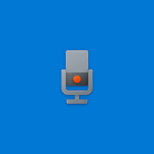
Windows Voice Recorder
Voice Recorder/Sound Recorder is an audio recording program included in most versions of the Microsoft Windows family of operating systems – many versions available

Slide 8
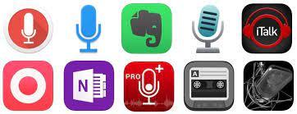
Voice Recorder App
Recordings are auto-saved and stored in your Documents folder for easy access
Easily share your recordings with friends and family, or send recordings to other apps
Play back, trim, rename, and delete your recordings
Mark key moments in the recording

Slide 9
Reference
https://www.mitel.com/features-benefits/voice-recorder

